Slide 1


SAP OData Training
Day - 2.

Slide 2


Agenda Day - 2
How to Enable Gateway
What is RFC
Define System Alias
Important TCode’s
Describing Postman Tool
Understanding How to Use Postman
Describing EPM Data Model
What is BAPI
Important BAPI’s
Break
Flow of Development
Creating OData services with the SAP NetWeaver Gateway Service Builder
How to Register OData Service
Product, Supplier – GET ENTITYSET, GET ENTITY

Slide 3
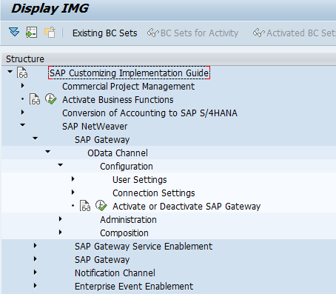
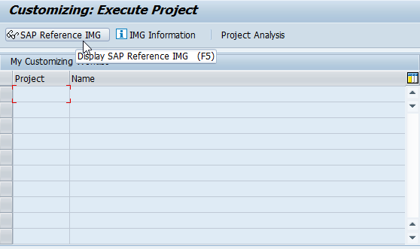
Steps for Enable SAP Gateway
Go to SPRO >> SAP Reference IMG.
Expand SAP NetWeaver >> Gateway >> ODATA Channel >> Configuration >> Activate or Deactivate SAP NetWeaver Gateway.
Click on Activate or Deactivate button to activate or deactivate SAP NetWeaver Gateway. In this case gateway is already activated.
01
Software Innovation
02
Hardware Innovation
Trainer : Anubhav Oberoy & Shubham Singh

Slide 4
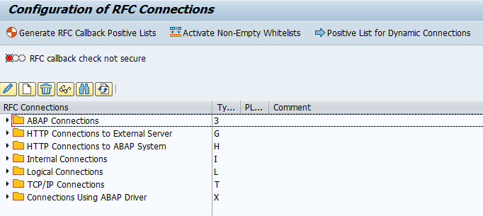
What is RFC
RFC is a mechanism that allows business applications to communicate and exchange information
(in pre-defined formats) with other systems. RFC stands for ‘Remote Function Call’
Tcode – “SM59”
RFC consists of two interfaces:
A calling interface for ABAP Programs
A calling interface for Non-SAP programs.
01
02
Trainer : Anubhav Oberoy & Shubham Singh

Slide 5
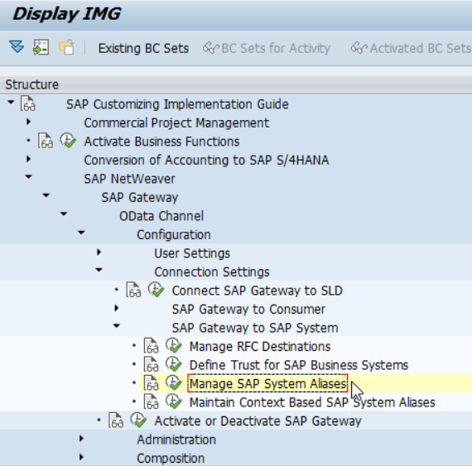
Define System Alias
Aliases are names that system administrators define for each system they create so that portal components can reference these systems. They are a means of retrieving the information stored on database servers without having to know the name of the server.
Procedure:
Use transaction SPRO
>>> SAP Reference IMG SAP Customizing Imp Guide
>>> SAP NetWeaver
>>> Gateway OData Channel
>>> Configuration
>>> Connection Settings
>>> Manage SAP System Aliases to OData Service.
Choose New Entries and enter the following:
Click Save to save your configuration settings.
01
Trainer : Anubhav Oberoy & Shubham Singh

Slide 6

Important TCode's
SEGW – Service Builder
/N/IWFND/MAINT_SERVICE – Maint Service / Registration of services
/N/IWFND/ERROR_LOG – Error logs of service calls
/N/IWFND/GW_CLIENT – Client Gateway / Test services locally within sap system
/N/IWFND/CACHE_CLEANUP - Cache Cleanup
02
Trainer : Anubhav Oberoy & Shubham Singh

Slide 7

Describing Postman Tool
Postman is an interactive and automatic tool for verifying the APIs of your project. Postman is a Google Chrome app for interacting with HTTP APIs. It presents you with a friendly GUI for constructing requests and reading responses. ... Postman is the way to streamline the process of API testing.
Postman is an API platform for building and using APIs. Postman simplifies each step of the API lifecycle and streamlines collaboration so you can create better APIs—faster.
Postman can run GET, POST, PUT, PATCH, MERGE, DELETE, and various other request methods as well, and also has utilities to help with developing APIs. Free and paid versions are available for Mac, Windows, Linux, and also as a Chrome app.
01
02
Hardware Innovation
Trainer : Anubhav Oberoy & Shubham Singh

Slide 8
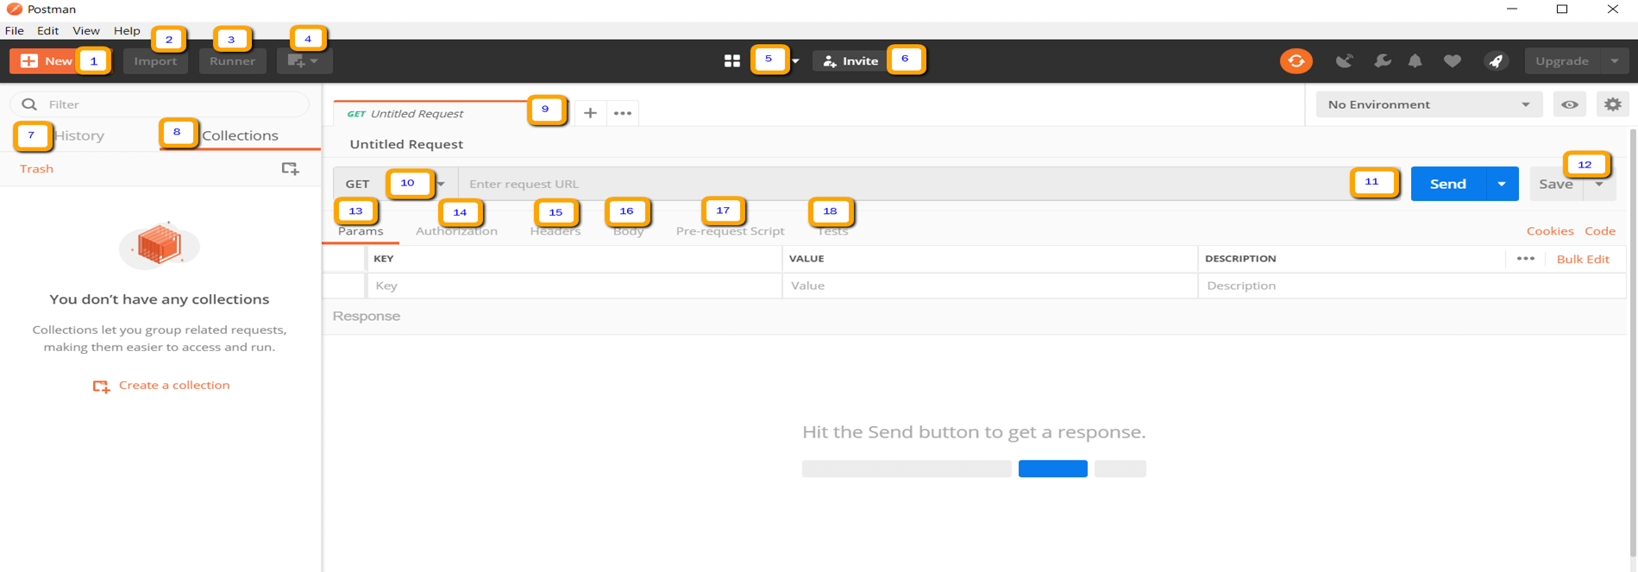
Steps for Perform Operation
Launch the Postman tool app.
Open the “Choose by User” template.
Select the “Choose by User” in the HTTP methods dropdown.
Pass the request URI in the address bar of Postman.
Pass request payload
Add authorization if applicable.
Add headers if applicable.
Click on the “Send” button.
View the response body and other details.
01
02
Hardware Innovation
Trainer : Anubhav Oberoy & Shubham Singh

Slide 9
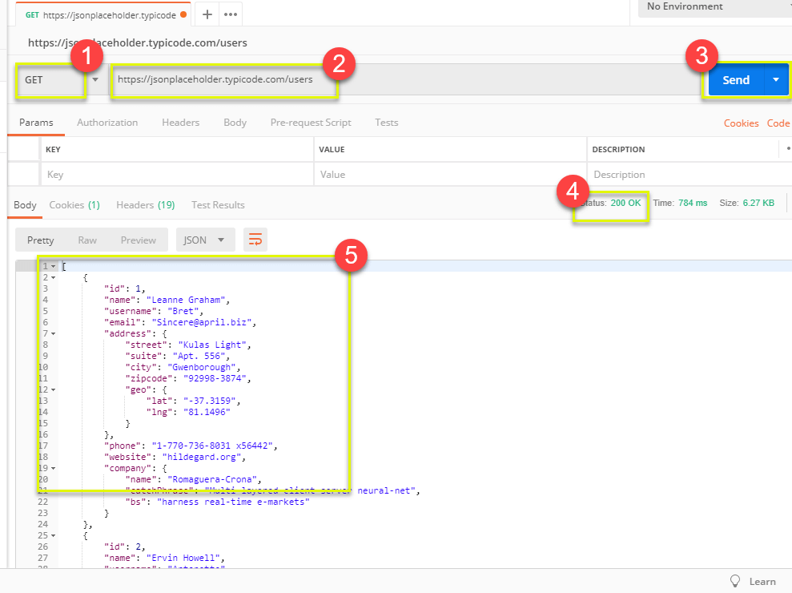
Understanding How to Use Postman
Get requests are used to retrieve information from the given URL. There will be no changes done to the endpoint.
We will use the following URL for all examples in this Postman tutorial
Introduction
02
Trainer : Anubhav Oberoy & Shubham Singh

Slide 10

Features of ADT ( ABAP Development Tool )
FREE and open source
Work with multiple systems parallelly
Fully customizable dev environment
It has integration with SAPGUI Ctrl+6
Fast Search and navigation
Ctrl+Shift+A – Search any object
Ctrl + T – Base classes
Integration with Transport Org, ATC
ABAP Profiles
This is the future of ABAP development on HANA and S/4HANA and even ABAP on Cloud
Verity of development using single tool – ABAP, UI5, HANA Native, Java, NodeJS, Android
Quick fix
Design time check on syntax
Code completion Ctrl+Space
Pretty Printer Ctrl+Shift+F
Code templates
Increases developer efficiency
ABAP has got new syntax, which means my old code is not dead and it will not work - False
Introduction
Trainer : Anubhav Oberoy & Shubham Singh

Slide 11
EPM Data Model
Real-time like demo data model which includes database tables, FMs, classes, Scenarios for training purpose and very much similar to real-life.
Products
Texts
Purchase Order Header
Items
100 Laptops
300 HDD
50 Projectors
….
Sales Order Header
Items
10 Laptops
3 HDD
5 Projectors
ITeIO
Electronics goods supplier (Amazon)
Introduction
Customers (BP)
Suppliers (BP)
Invoice
Invoice Items
6 laptop
3 HDD
2 Projector
01
Software Innovation
Stock
Invoice Line Item <= Sales Order Line item
6 laptop
3 HDD
2 Projector
02
Trainer : Anubhav Oberoy & Shubham Singh

Slide 12
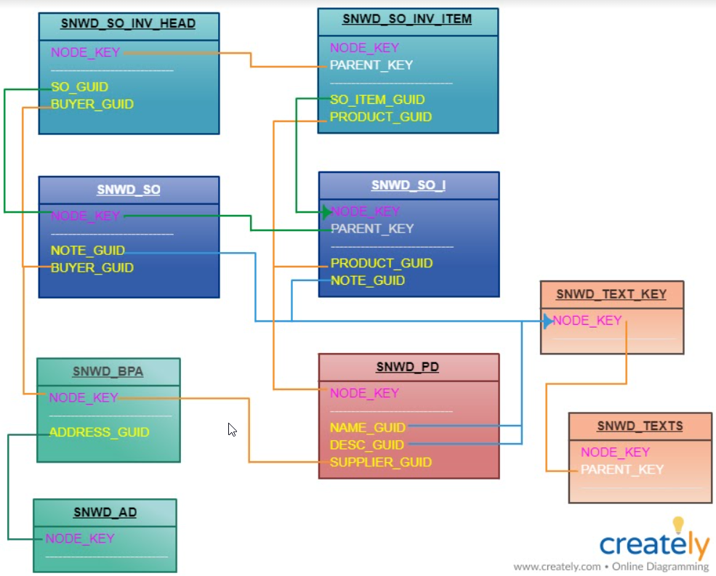
Important Tables for EPM
SNWD_PD – Products
SNWD_TEXTS – Product Descriptions
SNWD_BPA – Business Partners
SNWD_AD – BP Addresses
SNWD_SO – Sales orders
SNWD_SO_I – Sales Order Items
SNWD_SO_INV_HEAD – Invoice header
SNWD_SO_INV_ITEMS – Invoice items
….
Introduction
01
02
Trainer : Anubhav Oberoy & Shubham Singh

Slide 13
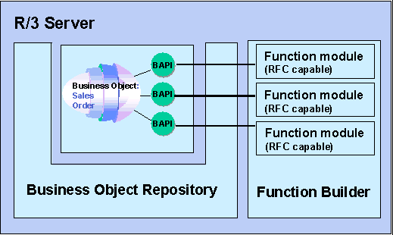
What is BAPI ?
BAPIs ( Business Application Programming Interface ) are specific methods for SAP business objects, which are stored in the Business Object Repository (BOR) of the SAP system and are used for carrying out particular business tasks.
Business Application Programming Interface(BAPI) are standardized programming interfaces (methods) enabling external applications to access business processes and data in the R/3 System.
They provide stable and standardized methods to achieve seamless integration between the R/3 System and external applications, legacy systems and add-ons.
BAPIs are defined in the BOR(Business object repository) as methods of SAP business object types that carry out specific business functions.
They are implemented as RFC-enabled function modules and are created in the Function Builder of the ABAP Workbench.
Some BAPIs and methods provide basic functions and can be used for most SAP Business Objects. These are called STANDARDIZED BAPI's.
Introduction
01
Software Innovation
02
Trainer : Anubhav Oberoy & Shubham Singh

Slide 14
Important BAPI’s
Enterprise Procurement Model – Products, Business Partner (Suppliers and Customers), Orders and Order Items.
BAPIs = Function Modules which are reusable and can be called from another systems as well
BAPI_EPM*
BAPI_EPM_PRODUCT_GET_LIST – All the list of products in the system
BAPI_EPM_PRODUCT_GET_DETAIL – details of a single product
BAPI_EPM_PRODUCT_CREATE – create a new product
BAPI_EPM_PRODUCT_UPDATE – update existing product
BAPI_EPM_PRODUCT_DELETE – delete the product
Business partners (BP)
BAPI_EPM_BP_GET_LIST
BAPI_EPM_BP_GET_DETAIL
BAPI_EPM_BP_CREATE
BAPI_EPM_BP_UPDATE
BAPI_EPM_BP_DELETE
Introduction
CRUD
01
Software Innovation
Create
Read
Update
Delete
Trainer : Anubhav Oberoy & Shubham Singh

Slide 15

Break

Slide 16
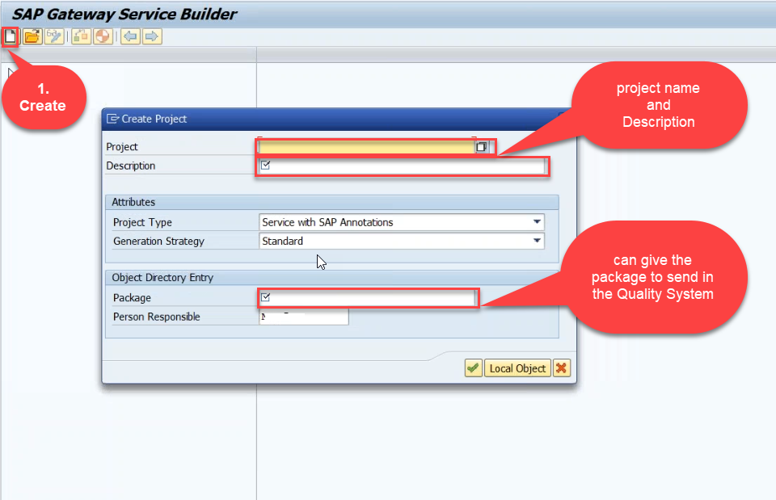
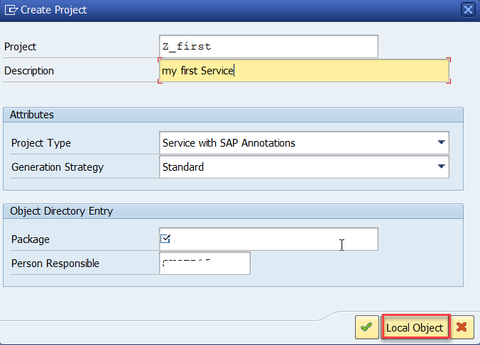
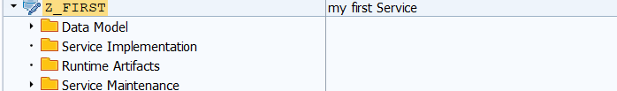
Creating OData Service
Step1: Start your SAP LOGON, and to Sap Gateway Service Builder(SEGW) and click on Create
Introduction
01
Software Innovation
02
Hardware Innovation
Trainer : Anubhav Oberoy & Shubham Singh

Slide 17
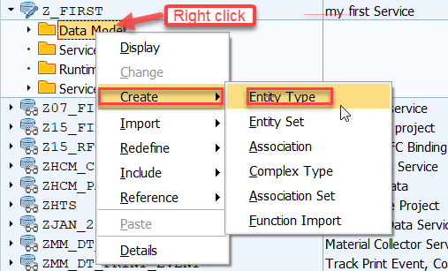
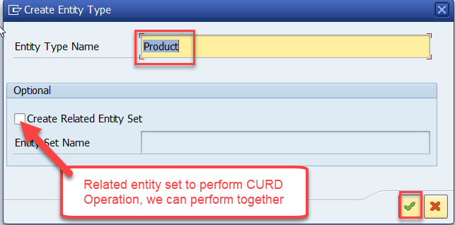
Creating OData Service
Step2: Defining the Data Model (Blue print of data)
01
02
Trainer : Anubhav Oberoy & Shubham Singh

Slide 18
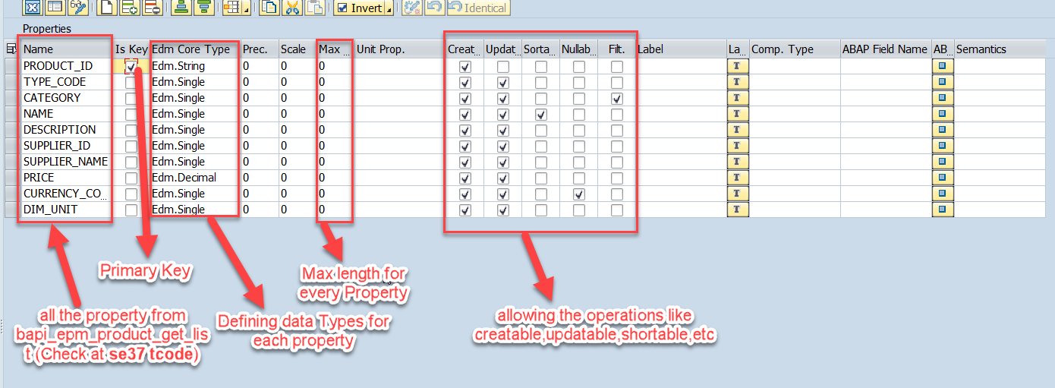
Creating OData Service
Step3: Creating Properties for data model (from bapi_epm_product_get_list (tcode- se37))
01
Software Innovation
02
Hardware Innovation
Trainer : Anubhav Oberoy & Shubham Singh

Slide 19
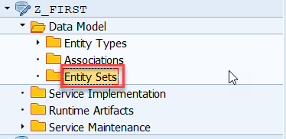
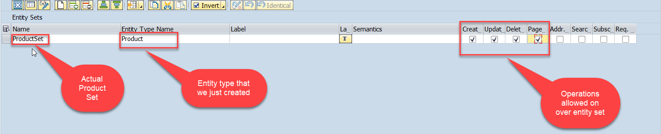
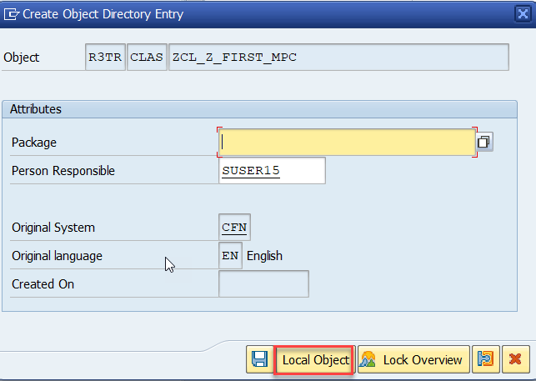
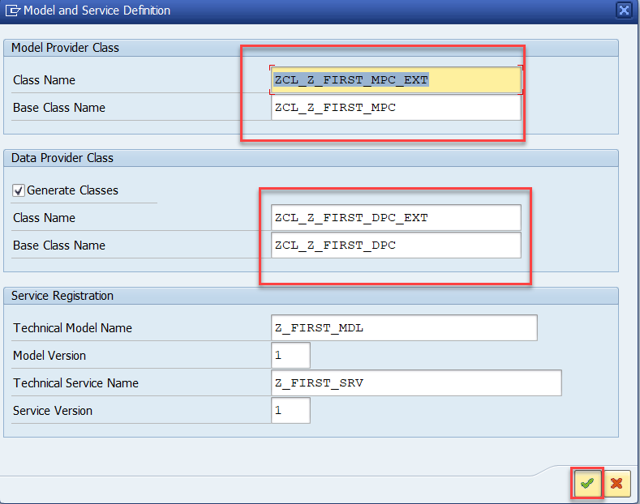
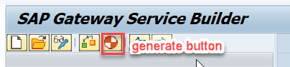
Creating OData Service
Step4: Creating entity set to perform actual CURD operations and service generation
01
Software Innovation
02
Hardware Innovation
Trainer : Anubhav Oberoy & Shubham Singh

Slide 20
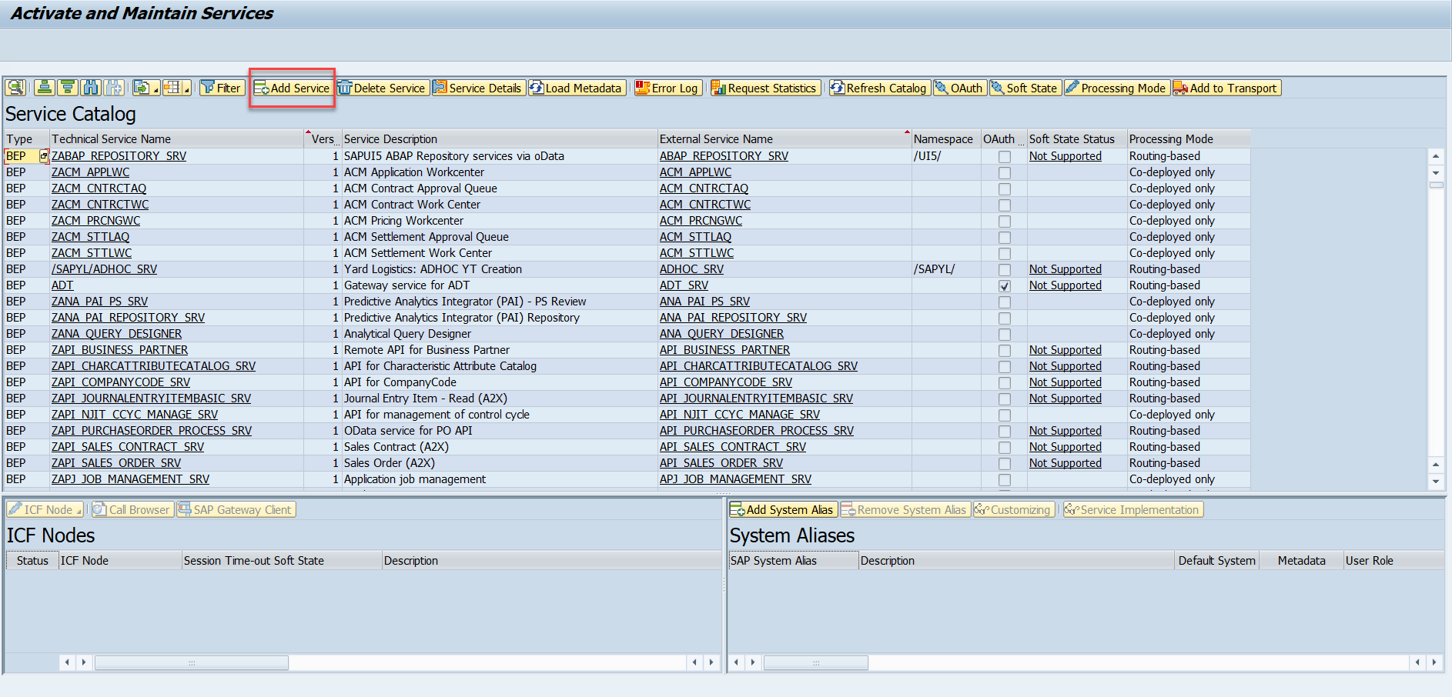
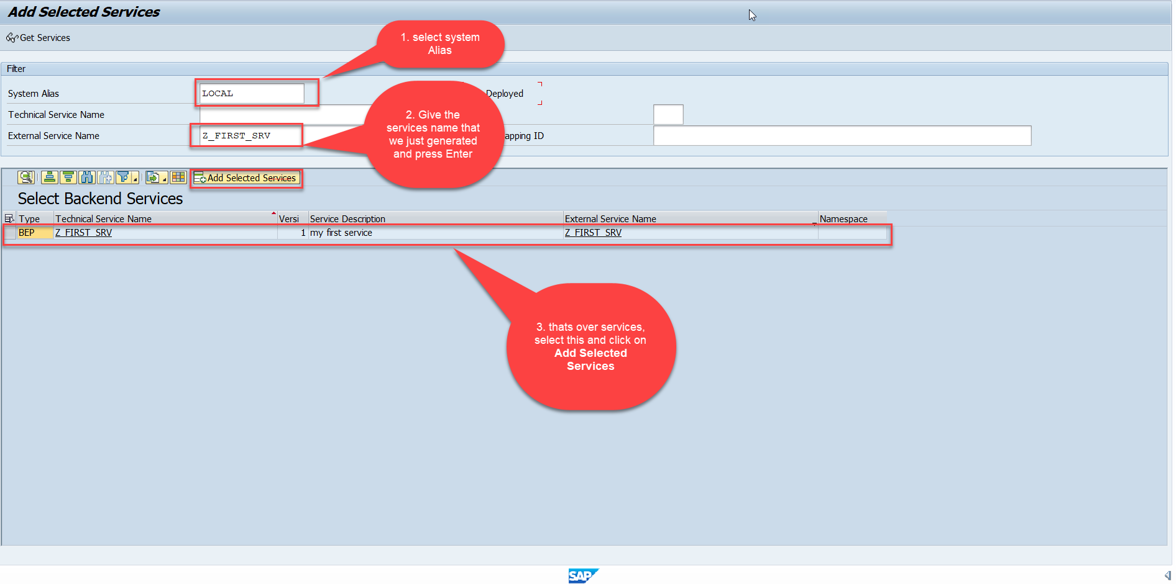
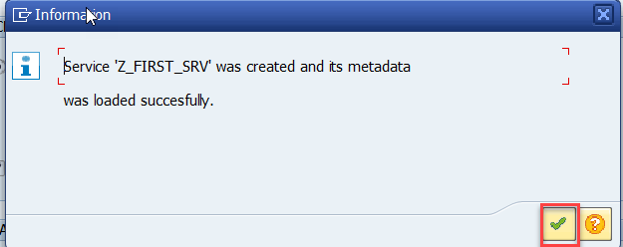
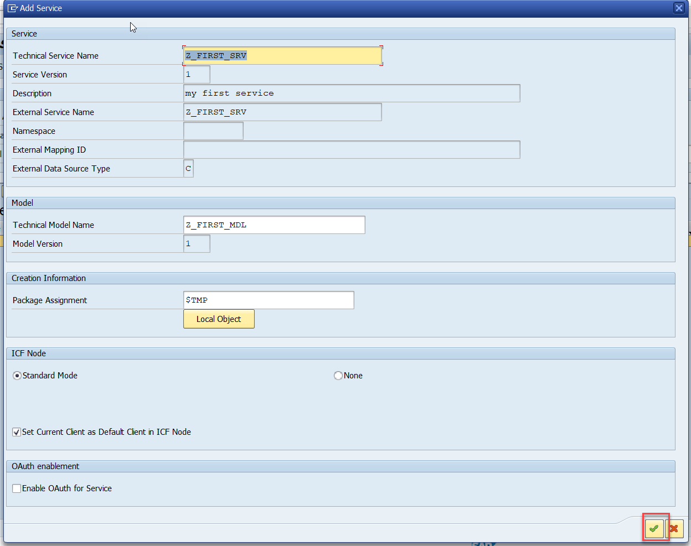
Creating OData Service
Step5: Service Registration (Go to tcode- /iwfnd/maint_service)
01
Software Innovation
02
Hardware Innovation
Trainer : Anubhav Oberoy & Shubham Singh

Slide 21
ABAP SEGW CLASSES
It has the code which provides the metadata
SAP Generated
It has the code which provides the actual data in the output when Entityset is called
Runtime Artifacts
MPC
(Model provider Class)
DPC
(Data Provider Class)
MPC_EXT (Extension)
Code which developer will write
DPC_EXT (Extension)
All the ABAP Code which works with CRUD implementations
01
Software Innovation
02
Hardware Innovation
Trainer : Anubhav Oberoy & Shubham Singh

Slide 22
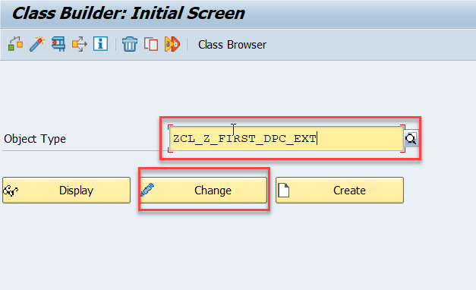
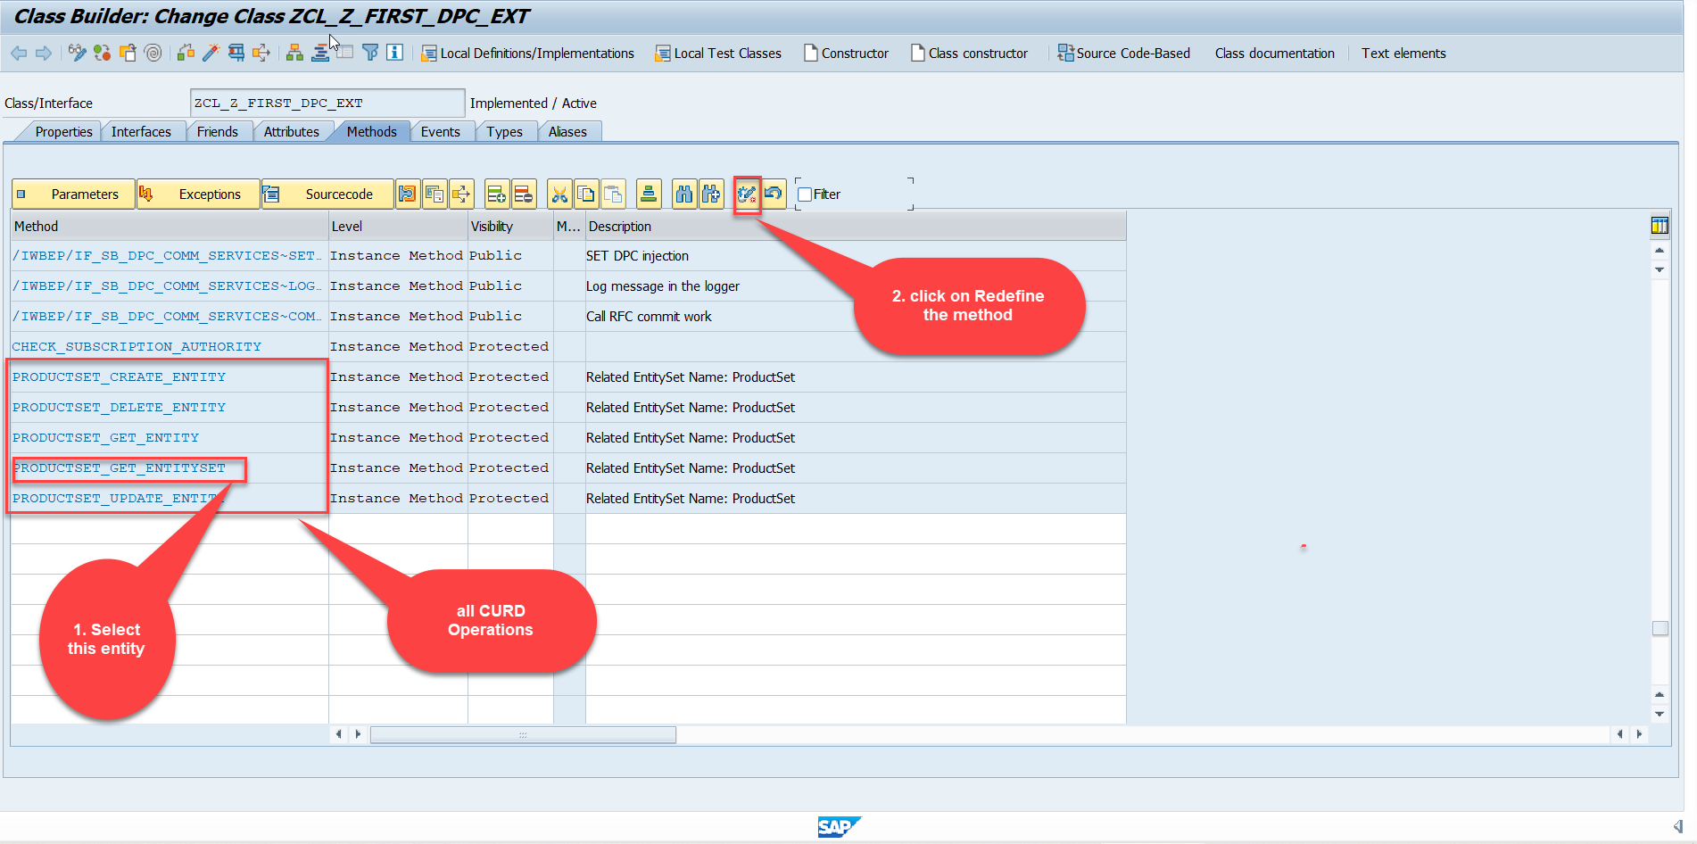
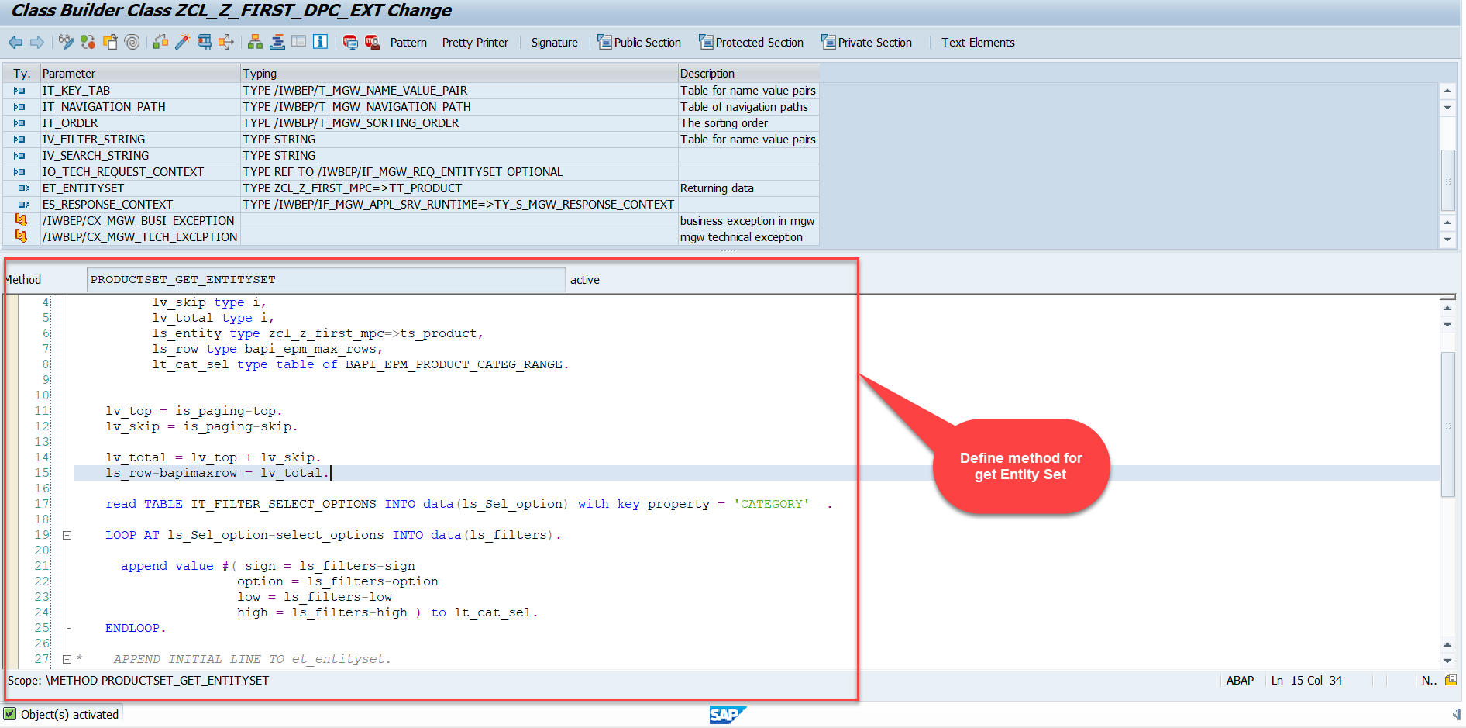
Building GetEntitySet Method
Step1: ProductSet Get Entity method(with filter, top and skip) in DPC Extension (Class Builder tcode- se24)
01
Software Innovation
02
Hardware Innovation
Note: Click on the image to get Complete code.
Trainer : Anubhav Oberoy & Shubham Singh

Slide 23
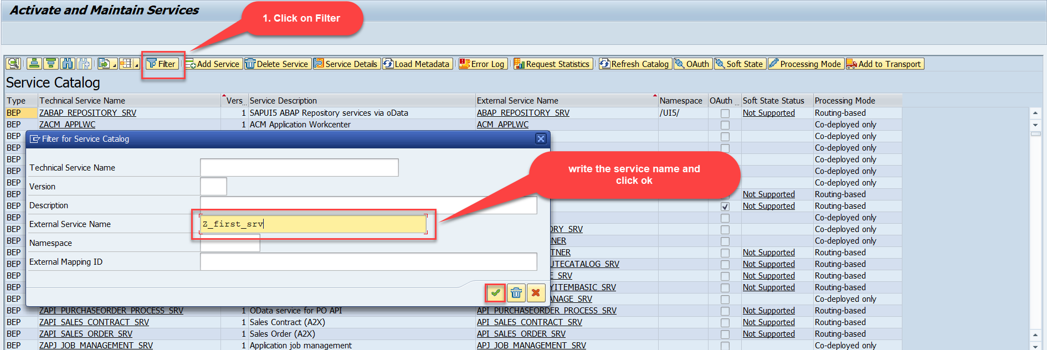
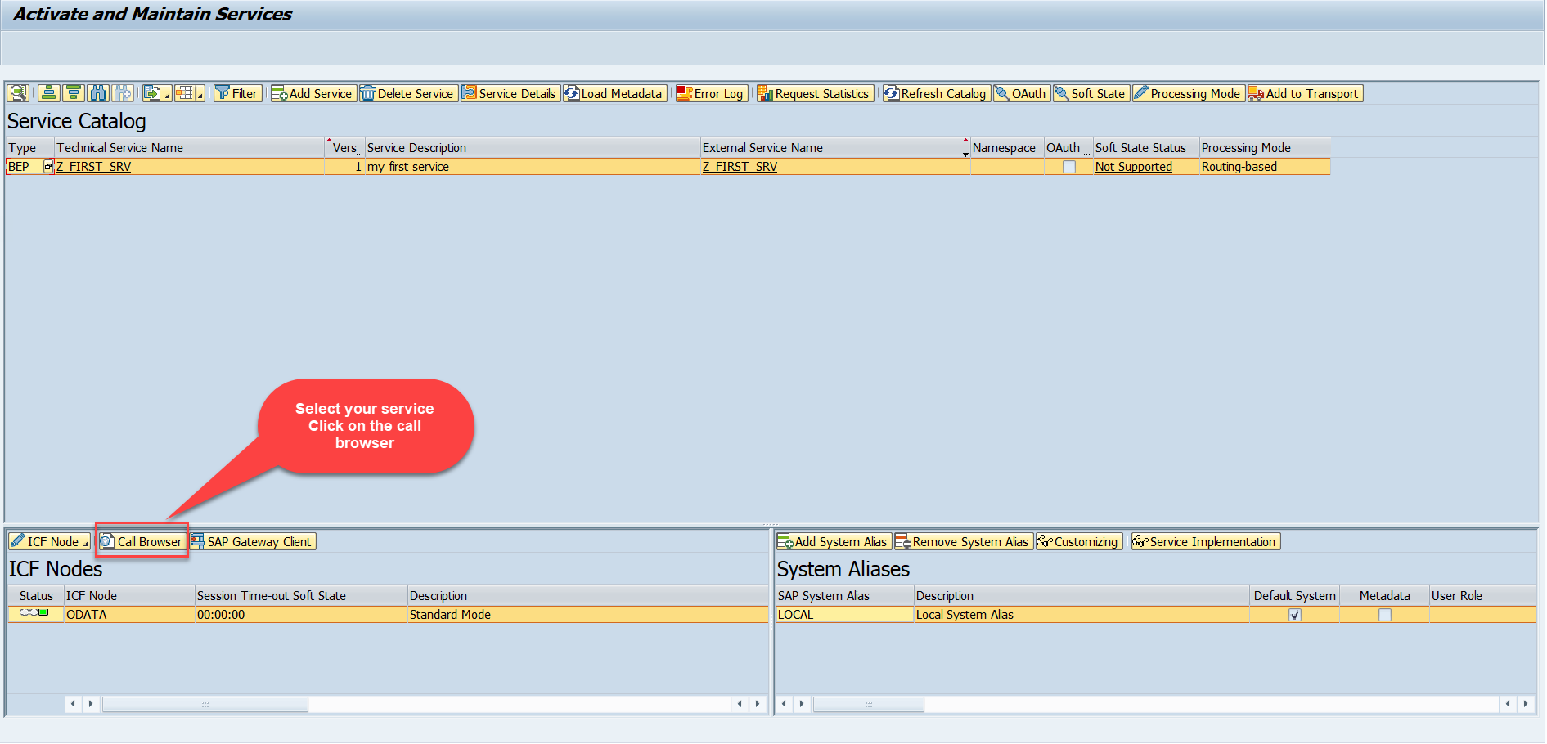
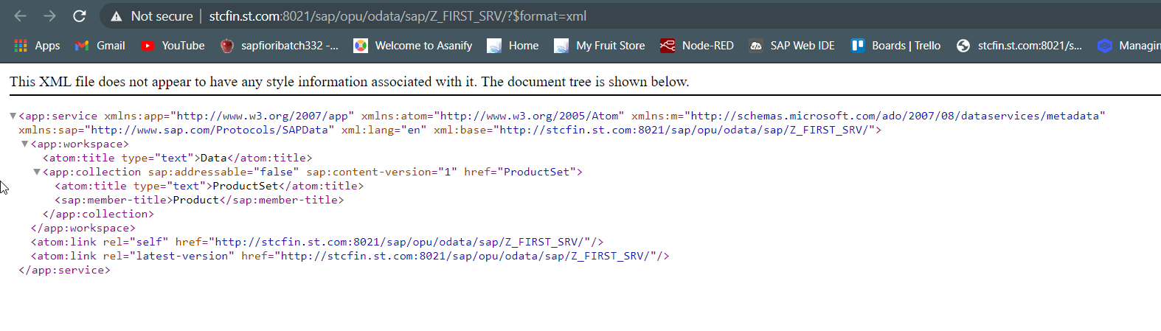
Building GetEntitySet Method
Step2: Call the service to the browser that we just created (go to service maintain (/iwfnd/maint_service))
01
Software Innovation
02
Hardware Innovation
Note: Click on the image to get Complete code.
Service in Browser
Trainer : Anubhav Oberoy & Shubham Singh

Slide 24
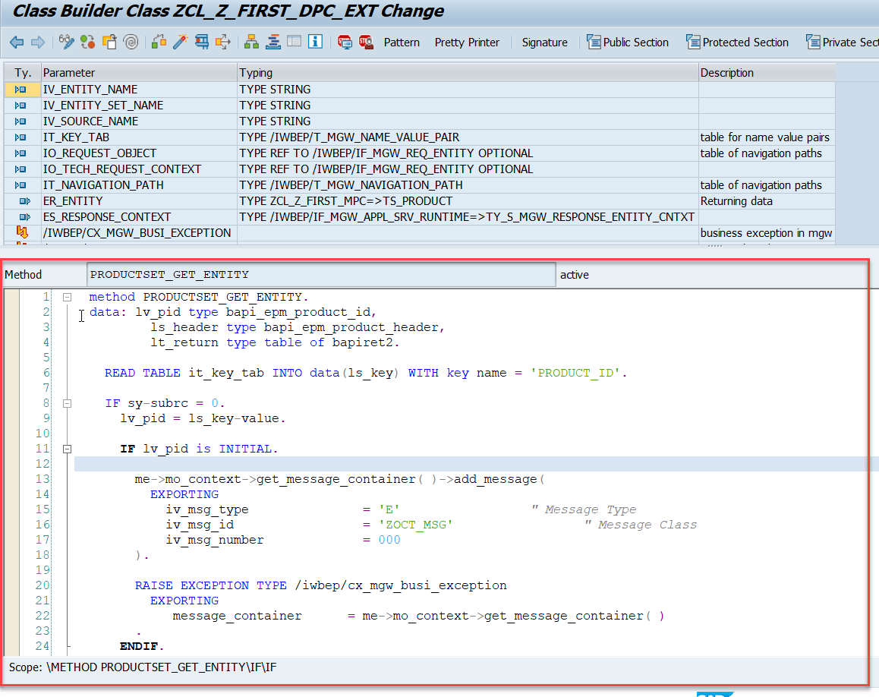
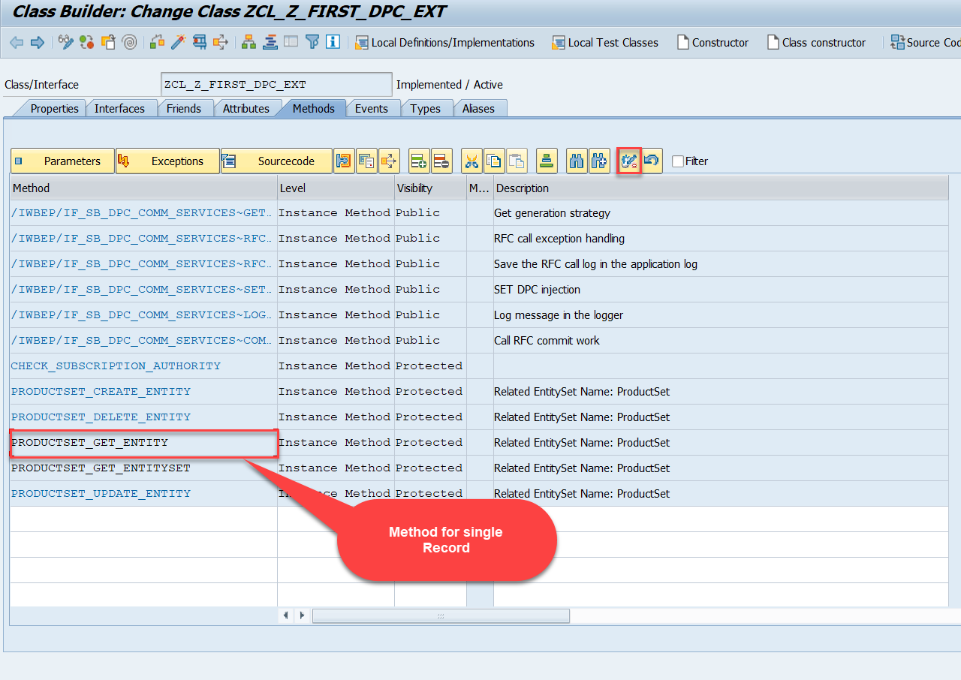
Building GetEntity(Single Record) Method
Go to DPC Extension of over service and redefine the method PRODUCTSET_GET_ENTITY
Introduction
01
Software Innovation
02
Note: Click on the image to get Complete code.
Trainer : Anubhav Oberoy & Shubham Singh

Slide 25

Summarize
End of Day 2

Slide 26

Questions

Slide 27

ANUBHAV OBEROY
www.anubhavtrainings.com
THANK YOU
“You can never leave footprints that last if you are always walking on tiptoe.”
Notes:
https://pixabay.com/photos/men-employees-suit-work-greeting-1979261/

Slide 28


We’re committed to empower you to be
Most Desirable Resource
through powerful training solutions.
We build the workforce of the future.
250+
Corporate Clients
30,000+
Learners Trained
25000+
Learners Placed
FREE WEBINARS
Sign up for free webinars with industry experts every fortnight!
Enroll Now!
Contact us today!
https://anubhavtrainings.com/

Slide 29




More from AnubhavTrainings.com

